Slide 1





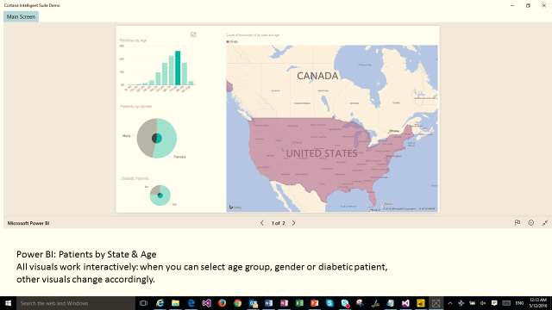
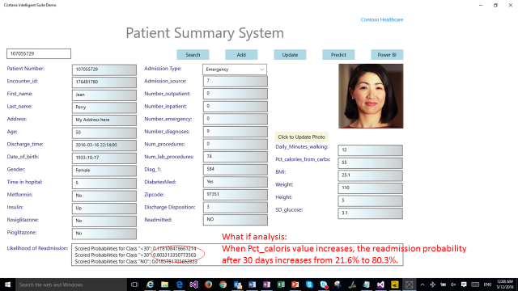

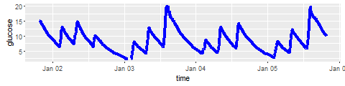





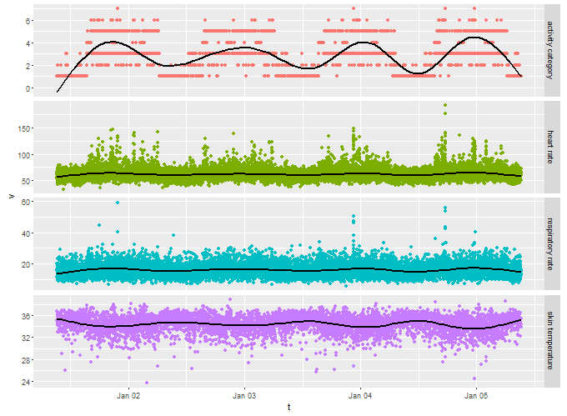


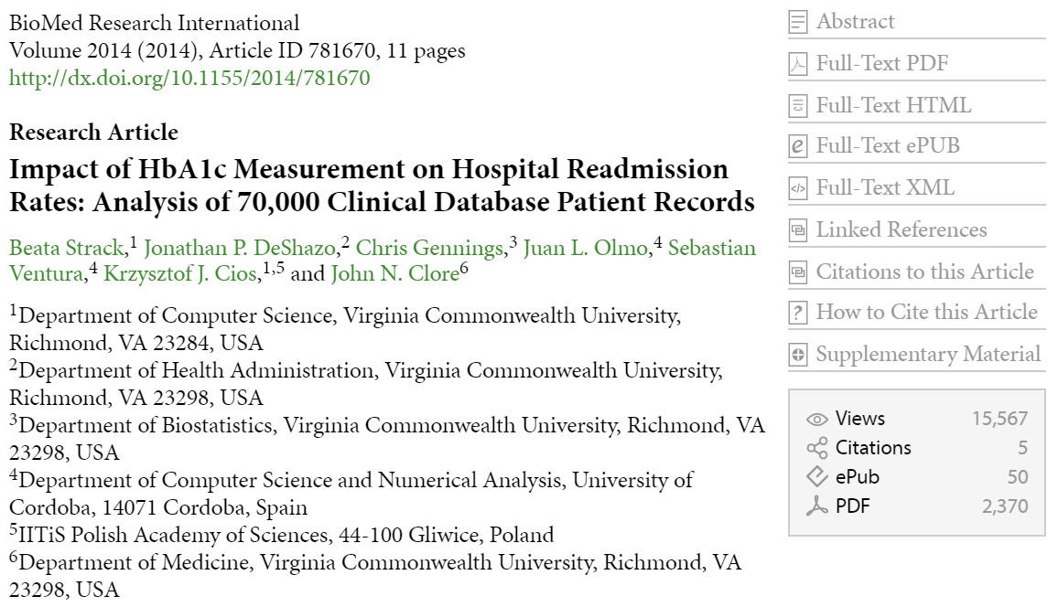
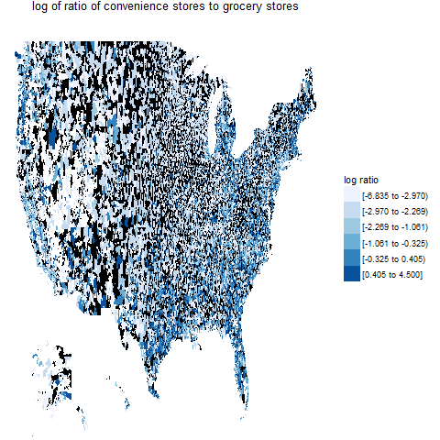
Activity & Vital Signs Quantifying overall activity level
Patient Health Analytics using the Cortana Intelligence Stack
Joy Qiao, Jing Chang, and Bob Horton, ADS ISV Ecosystem Team
Realizing that our healthcare customers were getting tired of seeing technical demonstrations about mortgages, taxi rides and airline flight delays, we have used simulations to construct a large set of data for a health care analytics use case. Starting with published anonymized data about hospital readmissions for diabetic patients, we generated fictitious personal details (name, birthdate, zipcode, weight), reverse-engineered admission histories, and simulated a variety of additional data sources from which we can engineer analytical features. These include grocery purchases (used to estimate percentage of calories from carbohydrates in the diet), continuous glucose monitoring measurements (used to calculate the variability of blood glucose levels), and wearable activity sensor data. We use Hive, Pig, Spark, and Microsoft R Server on an HDInsight cluster to extract the features from these large datasets, then build and deploy a predictive model on Azure ML. Data ingestion, processing and feature engineering are automated with Azure Data Factory. Since there are no privacy concerns with this simulated data, it should be useful for a variety of training exercises and demonstrations for customers in the healthcare industry.
Demonstration Scenario: Given data from disparate sources, build and deploy a model to predict the probability that a given patient will be readmitted within 30 days of being discharged from the hospital. Use high throughput approaches to extract or engineer appropriate features from data including demographic statistics, purchase histories, wearable sensor measurements, and electronic medical records.
Data Volume:
101,766 rows of patient records data
4,493,555 rows of grocery shopping data
166,852,080 rows of glucose sensor data
5,542,352,640 rows of vital sensor data
On-demand
Power BI
Event Hub
Prediction
Client Apps
Stream Analytics
Real-time
streaming
Azure Blob Storage / Data Lake Store
Embedded Power BI
Spark ODBC Driver
Glucose Readings
Azure ML
HDInsight
Apache Pig
Microsoft
R Server
Activity & Vital Signs
Text Extraction
Training & Model Selection
JSON to CSV & Formatting
data aggregation & denormalization
descriptive statistics
Batch processing (Azure Data Factory)
Structured EMR Data
Medical History
Zipcode
Purchase History
Now with SIMULATED
BONUS FEATURES!
History of present illness
This is a 49 year old normal weight Caucasian man admitted to the hospital from the emergency room.
Physical Exam
Vital signs: blood pressure 127/73, pulse 89, respiratory rate 22, weight 149.6 pounds, height 5ft 8in, BMI 23.
Medications
glipizide
insulin
Assessment
Secondary malignant neoplasm of lung
Malignant neoplasm of head of pancreas
Diabetes mellitus without mention of complication, type II or unspecified type, not stated as uncontrolled
diet_id | item | quantity | units
diet00001 | Wine table white | 100 | g
diet00002 | Avocado | 100 | g
diet00002 | Banana | 200 | g
diet00002 | Beer | 100 | g
diet00002 | Beets | 100 | g
diet00002 | Berries | 200 | g
diet00002 | Bologna | 100 | g
diet00002 | Broccoflower | 100 | g
diet00002 | Butter | 100 | g
diet00002 | Chard | 100 | g
diet00002 | Corn flakes | 200 | g

